Slide 1
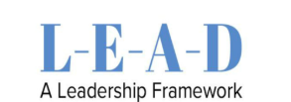

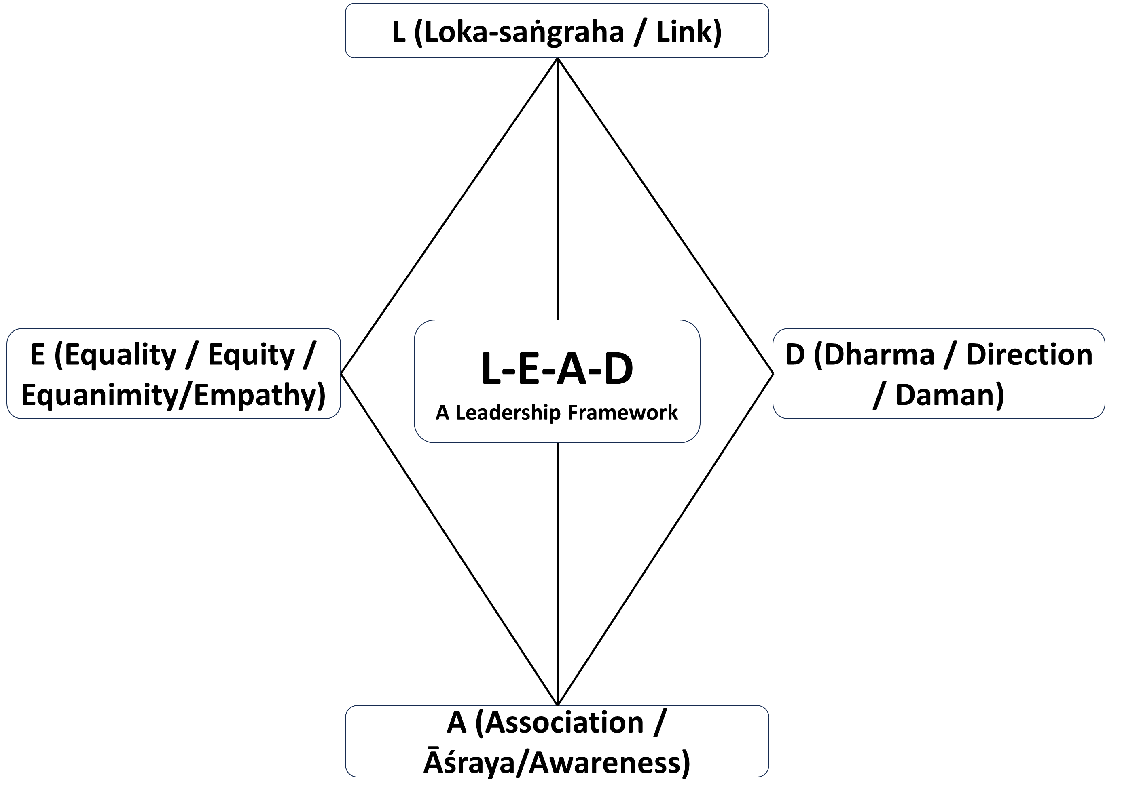
Prepared by Dr. Prem Prakash Pathak | Executive Alumni, IIM Kozhikode
LEAD Leadership Overview
Your LEAD profile shows a strong and balanced foundation across all four pillars — Loka-saṅgraha (Purpose), Equanimity (Balance), Association (Influence), and Dharma (Integrity). You demonstrate steady purpose, calm under pressure, moral fairness, and a sincere desire to learn and collaborate. This balance reflects a “stable tripod” of leadership energy — capable of adapting to diverse people and situations.
However, like all balanced profiles, there is a mild risk of diffused focus and delayed action if priorities are not regularly clarified. A clear North Star — a long-term vision or leadership goal — will help sustain direction, momentum, and impact.
Pillar Insights
Loka-saṅgraha: Purpose is expanding, supported by healthy habits. Strengthen clarity through quarterly resets and sharper prioritization.
Equanimity: You recover well from stress but sometimes delay responses. Define escalation cues and conduct “pre-fire drills” to maintain speed with calm.
Association: Curiosity drives learning, though unfiltered inputs may create noise. Do a source audit and form a trusted mentor panel to refine discernment.
Dharma: Fair and process-driven, though complex decisions may slow. Practice gray-zone simulations and build a principles playbook to act with clarity and courage.
Leadership Archetypes
You reflect a blend of mature and emerging archetypes, showing both depth and versatility:
Wise Altruist: Combines compassion with clarity; balances heart and KPIs.
Inclusive Influencer: Listens deeply; builds culture through diverse perspectives.
Purpose-Aligned Achiever: Ambitious yet ethical; focused on long-term, values-based success.
Long-Term Collaborator: Sustains systems; aligns stakeholders toward shared goals.
Reflective Thinker: Deeply analytical; benefits from faster, experiment-based execution.
Together, these patterns reveal a leader who thinks broadly, acts ethically, and seeks collective growth.
The opportunity ahead lies in translating insight into consistent execution — moving from thinking and caring to building and scaling.
Current Focus
There are moments when ownership becomes unclear, slowing action or decision-making. Strengthen follow-through through clear RACI roles, daily closure checklists, and sponsor-based accountability. This will help turn reflection into reliable outcomes.
Confidential & Personal
This report contains sensitive personal insights. It is intended solely for the recipient and should not be shared, distributed, or discussed without explicit consent.

Slide 2
Prepared by Dr. Prem Prakash Pathak | Executive Alumni, IIM Kozhikode
Your Leadership Foundations
T-Score
57.1 (Balanced)
T-Score
52.8 (Balanced)
T-Score
52.7 (Balanced)
T-Score
46.7 (Balanced)
Pillar L — Loka-saṅgraha (Collective Purpose)
Balanced: Decent balance; scope growing.
Strength: Healthy routines and expanding outreach.
Risk: Tendency to drift without a sharp anchor.
Focus: Do a quarterly reset; practice ruthless prioritization.
Pillar A — Association (Influence and Network)
Developing: Curious but unfiltered; seeks wide inputs.
Strength: Eager to learn from diverse voices.
Risk: Noise and manipulability in guidance.
Focus: Do a source audit; form a trusted mentor panel.
Pillar E — Equanimity (Balance in Mind and Response)
Balanced: Mostly even and composed.
Strength: Recovers well from pressure.
Risk: Calmness may slip into slow response.
Focus: Conduct pre-fire drills; set clear escalation cues.
Pillar D — Dharma (Integrity and Judgment)
Balanced: Compliant and fair in most cases.
Strength: Follows process and shows moral steadiness.
Risk: Decision-making may slow at the edges.
Focus: Define decision SLAs; practice making tough calls.
Focus: Grey-zone practice; principles playbook.
Confidential & Personal
This report contains sensitive personal insights. It is intended solely for the recipient and should not be shared, distributed, or discussed without explicit consent.

Slide 3
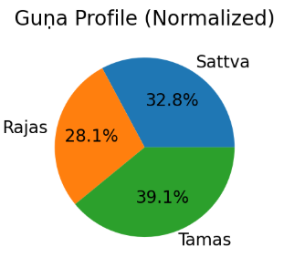
Prepared by Dr. Prem Prakash Pathak | Executive Alumni, IIM Kozhikode
Your Inner Energy (Guṇa)
Dominant Guṇa: Tamas
Normalized %: S 32.8% · R 28.1% · T 39.1%
T-scores: S 43.1 · R 45.2 · T 53.0
Dominant Guṇa is identified by the highest share of earned points relative to each Guṇa’s own maximum; Leaning normalizes Guṇa shares so S+R+T=100 for comparison. T-scores compare you to a reference group (mean 50, SD 10).
T – Tamas Dominant (“Mountain in mist”)
Remark:
Your leadership shows Tamas-dominant steadiness — stable, grounded, and calm like a mountain in mist. You bring order and dependability when chaos surrounds others.
However, this calm can slip into inertia or indecision if not balanced with light and motion. To evolve, ignite Sattva: seek openness, act in small, visible steps, and celebrate progress.
Recommendation:
Cultivate transparency and small wins. Clarify priorities, communicate openly, and track progress visibly. Each conscious action lifts the mist, transforming stability into purposeful momentum.
Confidential & Personal
This report contains sensitive personal insights. It is intended solely for the recipient and should not be shared, distributed, or discussed without explicit consent.

Slide 4
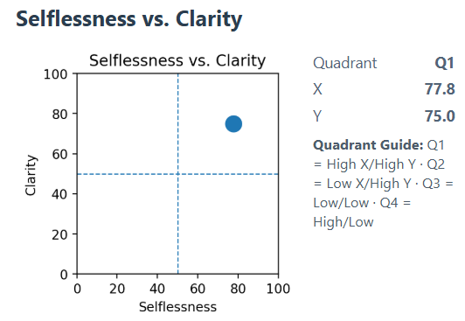
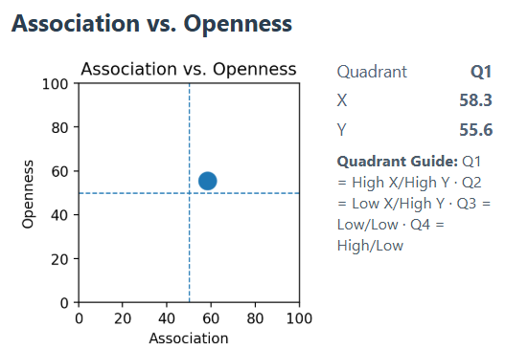
Prepared by Dr. Prem Prakash Pathak | Executive Alumni, IIM Kozhikode
Your Leadership Profile Across Six Key Matrices
You are a Wise Altruist — a leader who combines deep compassion with strategic clarity. You demonstrate a strong sense of purpose supported by clear KPIs, balancing head and heart to inspire trust, alignment, and responsible action across stakeholders.
Development Focus:
To strengthen this leadership profile further, continue to document and codify successful decision scenarios, especially those involving complex ethical or strategic trade-offs. Additionally, mentor peers and emerging leaders on applying values-based judgment in high-pressure or ambiguous situations.
You are an Inclusive Influencer — a leader who intentionally seeks diverse, wise perspectives and listens deeply. You cultivate a “mentor mosaic,” encourage constructive dissent, and serve as a strong carrier of positive culture and values.
Development Focus:
Enhance this strength by formalizing mentor-board style reviews, establishing rituals that normalize healthy dissent, and continuing to broaden talent pipelines to ensure diverse voices and future leadership readiness.
Confidential & Personal
This report contains sensitive personal insights. It is intended solely for the recipient and should not be shared, distributed, or discussed without explicit consent.

Slide 5
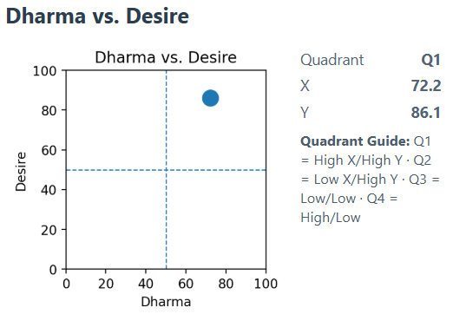
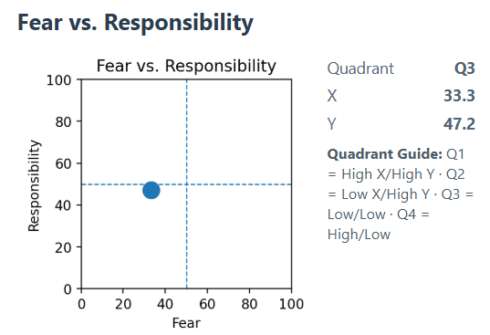
Prepared by Dr. Prem Prakash Pathak | Executive Alumni, IIM Kozhikode
Your Leadership Profile Across Six Key Matrices
You are a Purpose-Aligned Achiever — your ambition is anchored in service and long-term value creation. You scale impact ethically, build enduring competitive moats, and foster trust that compounds over time.
Development Focus:
Elevate this strength by teaching the principle of “right means for the right ends,” clearly codifying your non-negotiable values, and tracking values-aligned KPIs to reinforce responsible growth and mission integrity.
Current Pattern:
There are moments where responsibility is deferred and ownership becomes unclear, which can slow decision-making and impact team morale. This reflects a tendency to avoid difficult commitments or high-stakes choices when expectations or risks feel ambiguous.
Opportunity for Growth:
Strengthen accountability and follow-through by establishing clear RACI ownership structures, maintaining a daily commitment and closure checklist, and engaging a sponsor or accountability partner to ensure consistent progress on key priorities.
Confidential & Personal
This report contains sensitive personal insights. It is intended solely for the recipient and should not be shared, distributed, or discussed without explicit consent.

Slide 6
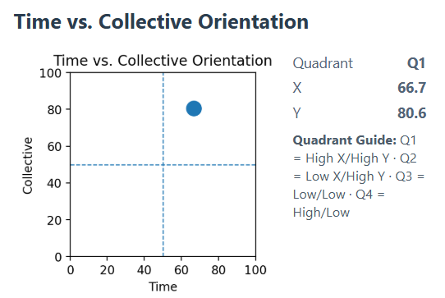
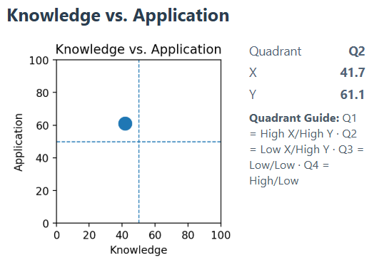
Prepared by Dr. Prem Prakash Pathak | Executive Alumni, IIM Kozhikode
Your Leadership Profile Across Six Key Matrices
You are a Long-Term Collaborator — a leader who sustains impact over time and builds enduring systems that serve many. You think beyond short-term wins, focusing instead on shared growth, patient capital, and solutions that work across teams and stakeholders. Your calm persistence and inclusive mindset help you align diverse interests toward a common good.
Development Focus:
Strengthen this leadership path by creating a 10-year strategic map that outlines long-term priorities and milestones. Define “commons” KPIs that encourage collaboration across departments or partners, and craft a legacy narrative that connects today’s actions to the larger purpose you aim to serve. This will help your leadership move from steady progress to lasting transformation — one that endures beyond projects, quarters, or roles.
You are a Reflective Thinker — a leader who values clarity, logic, and sound frameworks. You think deeply before acting and often bring structure and insight to complex issues. However, this strength can sometimes turn into over-analysis, leading to more discussion than execution. You may prefer whiteboards and slides over prototypes and outcomes, delaying tangible progress despite solid ideas.
Development Focus:
Convert reflection into momentum through time-boxed pilots and rapid learning cycles. Adopt a “build–measure–learn” rhythm — start small, test early, and refine as you go. Balance your thoughtful planning with visible action, ensuring that insight consistently turns into real-world results.
Confidential & Personal
This report contains sensitive personal insights. It is intended solely for the recipient and should not be shared, distributed, or discussed without explicit consent.

Slide 7
Prepared by Dr. Prem Prakash Pathak | Executive Alumni, IIM Kozhikode
Appendix
About the Framework & Book
The LEAD framework (Loka-saṅgraha, Equanimity, Association, Dharma) is a leadership model inspired by Indian Knowledge Systems (IKS). It emphasizes ethical clarity, self-mastery, right association, and service to the collective. A concise introduction appears in the book LEAD: A Leadership Framework from Indian Knowledge System. For the retail listing, see amazon.in/dp/937335308X.
Purpose of this Assessment
This assessment offers a structured mirror for leaders and teams. It summarizes patterns across six 2×2 matrices (e.g., Selflessness vs. Clarity; Dharma vs. Desire) and a Guṇa profile (Sattva–Rajas–Tamas), then maps results to the LEAD pillars. The aim is practical growth: clearer decisions, ethical steadiness, better associations, and outcomes aligned with long-term welfare.
Methodology (High Level)
Items use Likert-type responses. Each item is normalized to a 0–100 scale (with reverse-scoring where applicable) and aggregated into traits, matrices, Guṇa, and pillars. For comparability, we express results in T-scores (mean 50, SD 10) relative to a reference dataset; raw pillar and Guṇa percentages are also reported for intuitive reading. Quadrant narratives and coach actions come from the LEAD playbook. We monitor reliability and refine norms through ongoing calibration; interpretations are directional and best used with coaching and organizational context.
Good Use
Treat results as starting points for dialogue, not labels. Re-take after meaningful development intervals (e.g., 3–6 months) to observe trendlines rather than single scores.
Dr. Prem Prakash Pathak
Ph.D., CSIR–CDRI, Lucknow | Executive Alumni, IIM Kozhikode
Author — LEAD – A leadership Framework from IKS
Creator — LEAD Leadership Framework
📧 pvdas.rgm@gmail.com | 📞 +91-8956467539
🌐 www.pvdas.in
Confidential & Personal
This report contains sensitive personal insights. It is intended solely for the recipient and should not be shared, distributed, or discussed without explicit consent.

